Slide 1
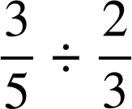
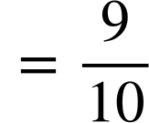

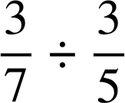
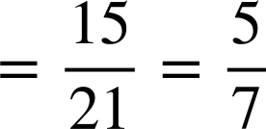
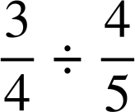
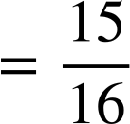
Dividing a fraction by a fraction
Task A: Dividing two fractions
1) Work out the answer to the following. You can use these templates for the area model if it helps.
2) Work out the answer to the following. You can use these templates for the area model if it helps.
3) Work out the answer to the following by drawing area models. Use squared paper if it helps.

Slide 2
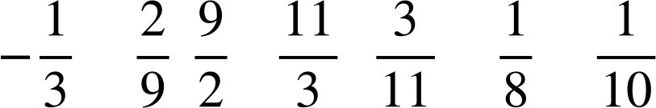
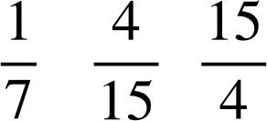
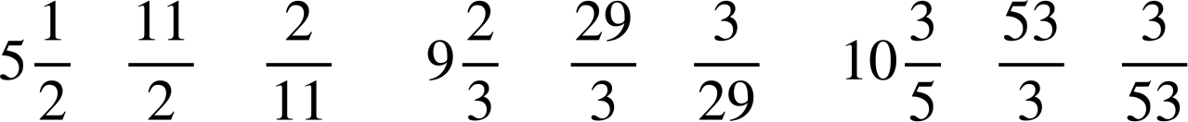

Dividing a fraction by a fraction
Task B: Reciprocals
1) Work out the reciprocals of the following.
a) 8 reciprocal is
b) 10 reciprocal is
c) 7 reciprocal is
d) -3 reciprocal is
e)
f)
g)
h) 1
reciprocal is
reciprocal is
reciprocal is
reciprocal is 1
2) Work out the reciprocals of the following.
a)
b)
c)
reciprocal is
reciprocal is
reciprocal is
3) Using the cards only once, make the following statements true.
1
2
2
4
5
8
10
E.g.
1
4
10
The
reciprocal
of
is
2
The
reciprocal
of
is
2
5
8
This is an equivalent fraction to the reciprocal

Slide 3
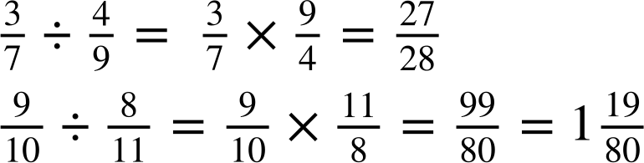
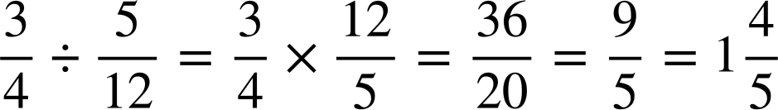
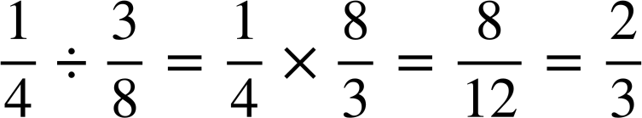
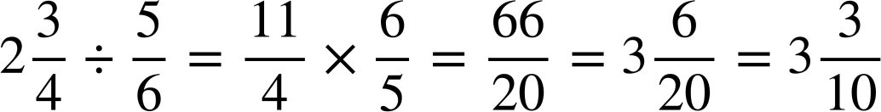

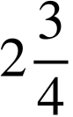
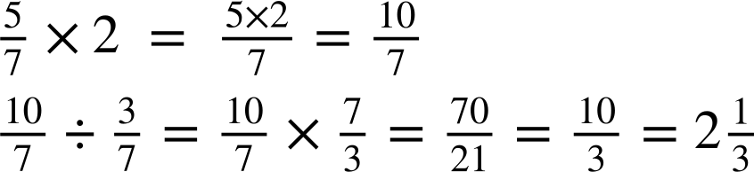
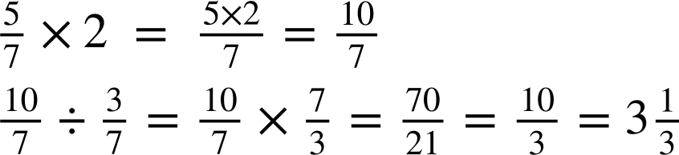
Dividing a fraction by a fraction
Task C: Division by multiplying by the reciprocal
1) Work out the answers to the following, simplifying your answer where necessary.
a)
b)
c)
2) Here are some areas of some shapes. Work out the missing lengths
a)
m
b)
cm
Area
cm²
Area
m²
cm
=
m
=
c)
m
Area
m²
=
m
Mathematics in Education and Industry
v2.2

